Slide 1

SUBJECT: Sales Force Management.
Case study no. 3
Group Members:
Ahmed Wedam Ahmed / 44509
Murat Akar / 44771
Kamilla Mambetova / 44773
Ayse Urs / 44378
Mubunda Eliezer / 44503

Slide 2
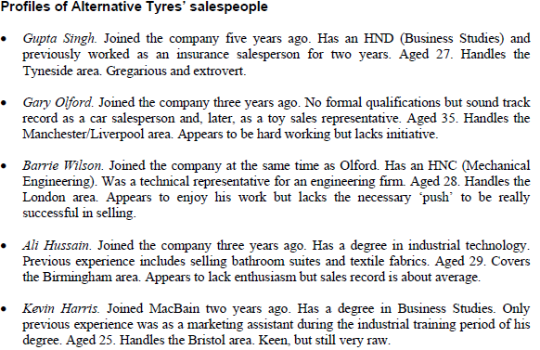
Evaluate the performance of each of Alternative Tyres salespeople

Slide 3
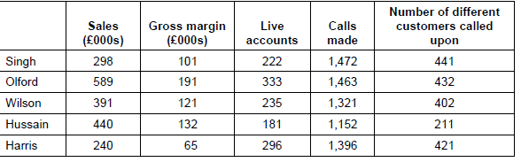
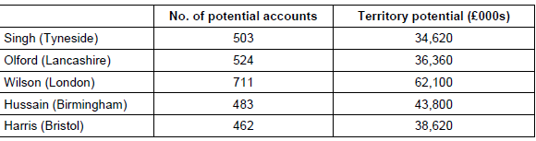
Salesforce Data - we have statistics per previous year and we does not have setted target for each salesperson. That is why we decided to find average number of live accounts gained per year. We sum the amount of all accounts and divide it to number of sales persons. 1267:5= 253 - average of live accounts per salesperson. We assume it (253) as minimum performance of sale person.
Market Data kkkk

Slide 4
Live accounts per number of different calls made, we decided to find it by dividing live accounts number to the numbers of different customers called
Singh - 222: 441 = 0.50
Olford - 333: 432 = 0.77
Wilson - 235: 402 = 0.58
Hussain - 181: 211 = 0.85
Harris - 296: 421= 0.70
Hussain, olford,harris, wilson and singh

Slide 5
Sales: Calls made live accounts per number of customers calls
This number is needed for finding who was more distructed
Sings - 298:1472 = 0.503
Olford- 589:1463 = 0.402
Wilson- 391:1321= 0.296
Hussain- 440 :1152 = 0.382
Harris- 220:1396 = 0.156

Slide 6
Gross margin per calls made
Singh- 101,000:1,472=68.61
Olford- 191,000:1,463=130.55
Wilson- 121,000:1,321=91.60
Hussain- 132,000:1,152=114.58
Harris- 65,000:1,396=46.56
Tells us how much profit was made on each call made

Slide 7
Gross margin per live account
Territory potential per potential account
Singh- 101,000:222= 454.95
Olford- 191,000:333= 573.57
Wilson- 121,000:235= 514.89
Hussain- 132,000:181= 729,28
Harris- 65,000:296= 219.59
Singh- 34,620 000:503= 68,827.03
Olford- 36,360 000:524= 69,389.31
Wilson- 62,100 000: 711= 87,341.77
Hussain- 43,800 000:483= 90,683.23
Harris- 38,620 000 :462=83,593.07
Notes:
if its a mistake then they have performed more than the potential, if not they all couldn't get to their potential.hence improvement needed.

Slide 8
What further information is needed to produce a more complete appraisal?
We also will need the following information:
Target for revenue per calls made
Company target (setted KPI’s)
Working hours of employees (part time/full time)
Number of sick leaves (that directly affect on the performance indicators)
Average lengths of the call
Additional tasks impact (more experienced workers may be at tranings or other additional things)

Slide 9
What action would you take with each salesperson?
Set KPI’s
Arrange tranings
Arrange additional 121 sessions in order to improve motivation.
Set up an additional rewards for high performance
Make them feel valued
Shadowing
Singh - we would arrange him 121 sessions with leader in order to keep him motivated and give him a chance to have a voice during the team meetings with some updates and performance statistics. It will motivate him to show higher results.
Olford - showing good performance. Have more potential due to experience and results. Need more motivation in order to be more initiative. Make him feel valued and rewards for high performance.
Wilson - additional tasks, set clear KPI’s and additional rewards.
Hussain - arrange individual 121 sessions, trainings, motivate by reward.
Harris - pay attention to additional tranings in order to get more experience, 121 sessions, shadowing by other colleagues.

